Slide 1
The 3 R’s of GED Prep: Recruitment, Retention, & Results
Liz Lanphear
August 2019

Slide 2
GED® - It is more than a test; it is a program!
To ensure that students have the knowledge and skills necessary to earn a high school equivalency credential
To enhance instruction so students are ready for postsecondary education and/or workforce training program
To provide instructors and test-takers with information they can use to enhance performance
Notes:
Key Points
This slide includes animations.
In the past, the focus of the GED Testing Service was on the development and delivery of the GED test. That all changed in 2014 with a three-pronged purpose. Review each purpose and discuss how that how brought about the change from test to program.

Slide 3
Agenda
Recruitment
Retention
Results

Slide 4
Helping students connect to you
GED Prep Connect
This Photo by Unknown Author is licensed under CC BY-NC-ND

Slide 5
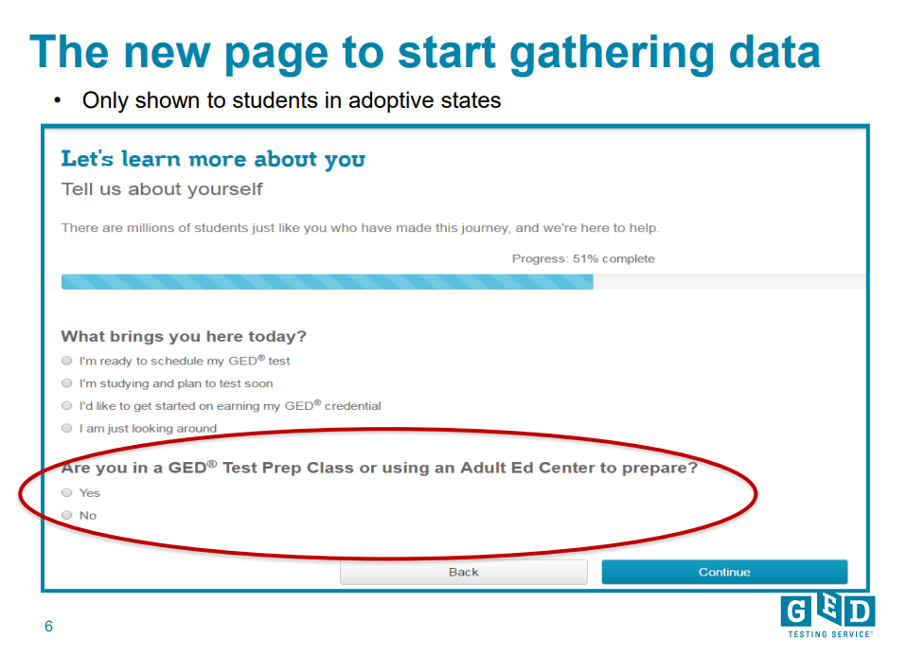

Slide 6
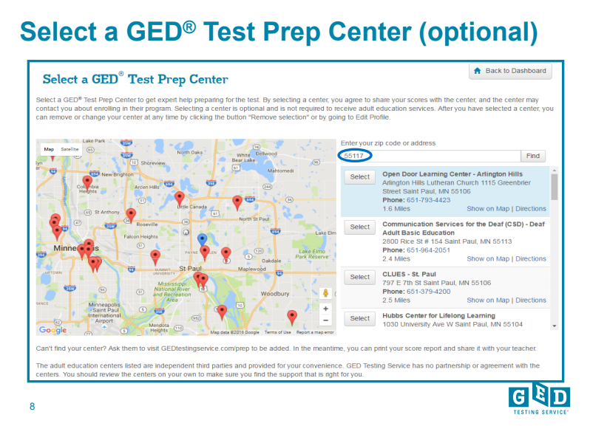
Student will enter their zip code to locate Test Prep Centers in their area

Slide 7
Once a program is selected, student has option to remove at any time

Slide 8
A variety of ways that students can share scores with your program
At the time of creating their account on GED.com
From their profile page
From the scores page
From their score report

Slide 9
GED Manager – Prep Connect Enabling Adult Ed Staff to Connect with potential students

Slide 11
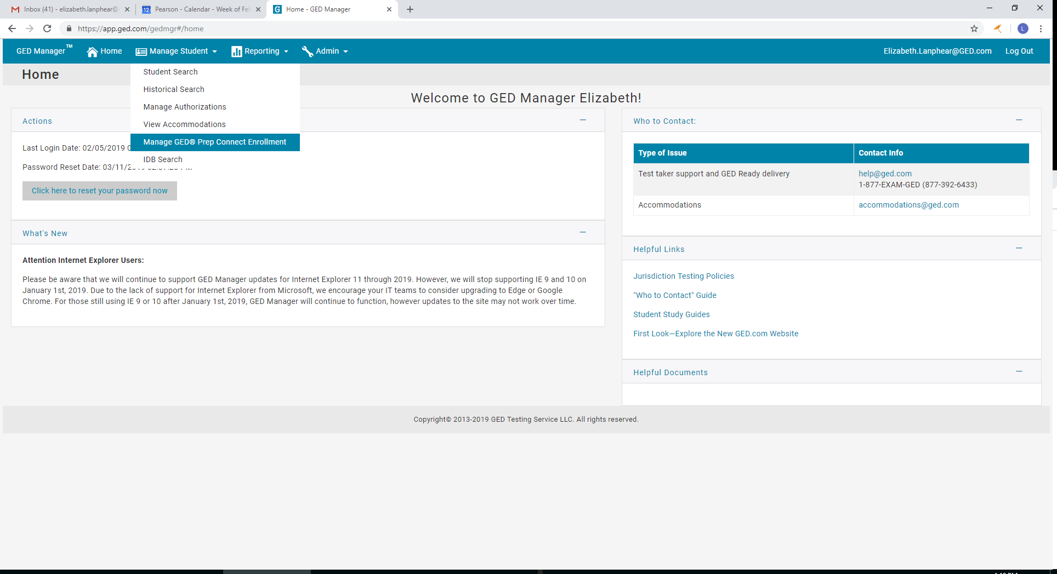
Click on Manage GED® Prep Connect Enrollment

Slide 13
Choose the Enrollment Status from the drop down menu

Slide 16
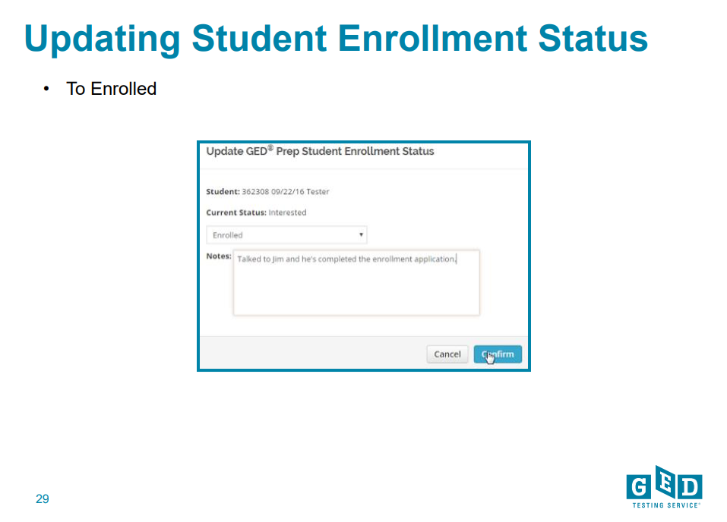

Slide 18
Tips for outreach to interested students
Make sure you update the status of the students in your program
Successful programs have teachers assigned to monitor GEDPrep Connect enrollment and reach out to Interested students
Do not be afraid to call or email students – they shared their contact information for a reason!
Consider using Remind.com to streamline outreach

Slide 19
Example of text message outreach via Remind.com
Notes:
Temple University and Altoona SD

Slide 20
Additional information available
Contact me for additional information
Or to do a webinar

Slide 21
Retention

Slide 22
GED Manager for Adult Educators
Looking up students
Managing enrollment
Running testing activity reports

Slide 23
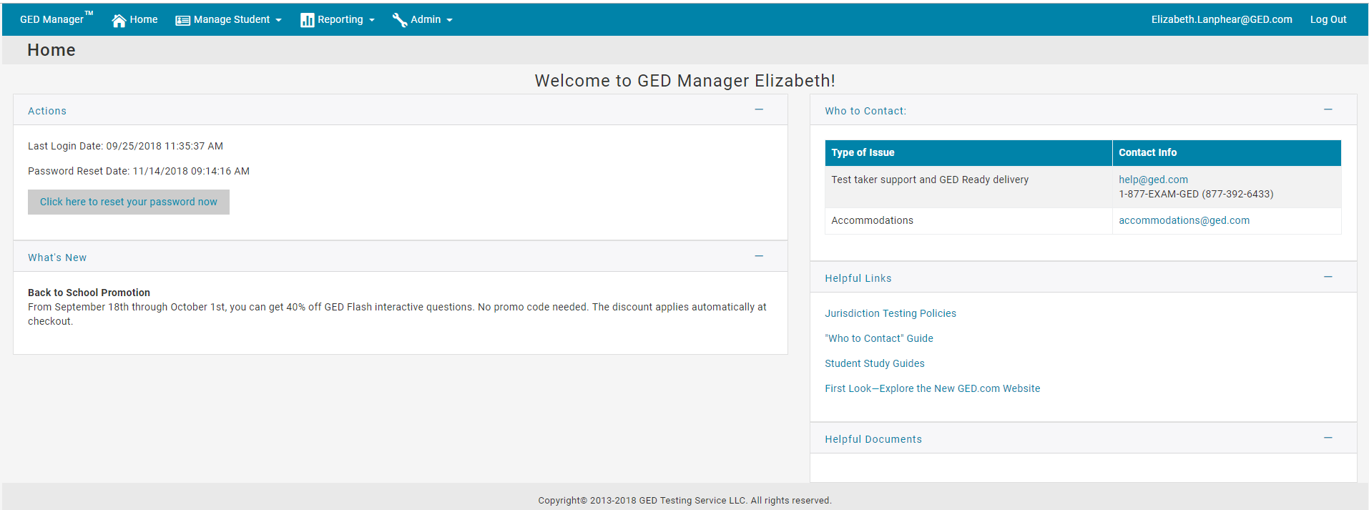
Adult Educator’s GED Manager home page
Notes:
Systems issues

Slide 24
Manage Student Options ➔ Student Search

Slide 25
Manage Student ➔ Student Search
You can look up one student at a time if you need to find specific information
When you click on the student’s name, you find out additional details about his/her activity, including test scores and demographic information

Slide 26
Student scores and score reports
Links to the detailed score report

Slide 27
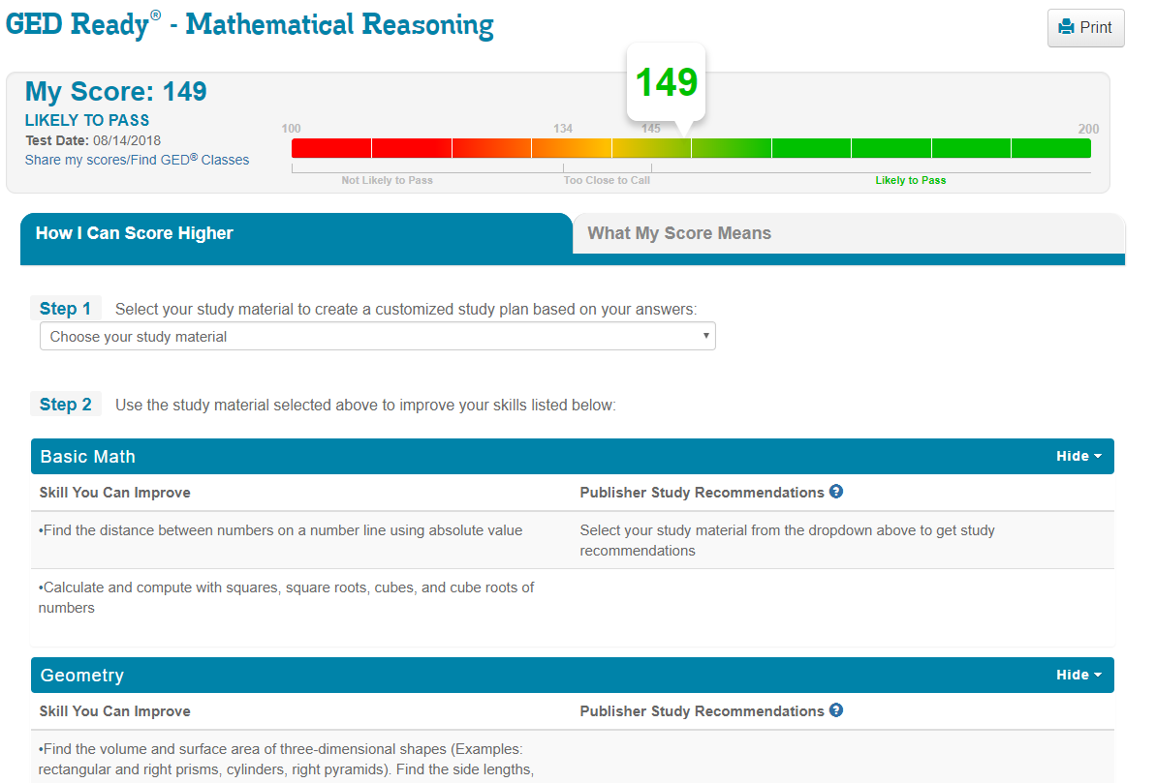
Score reports

Slide 28
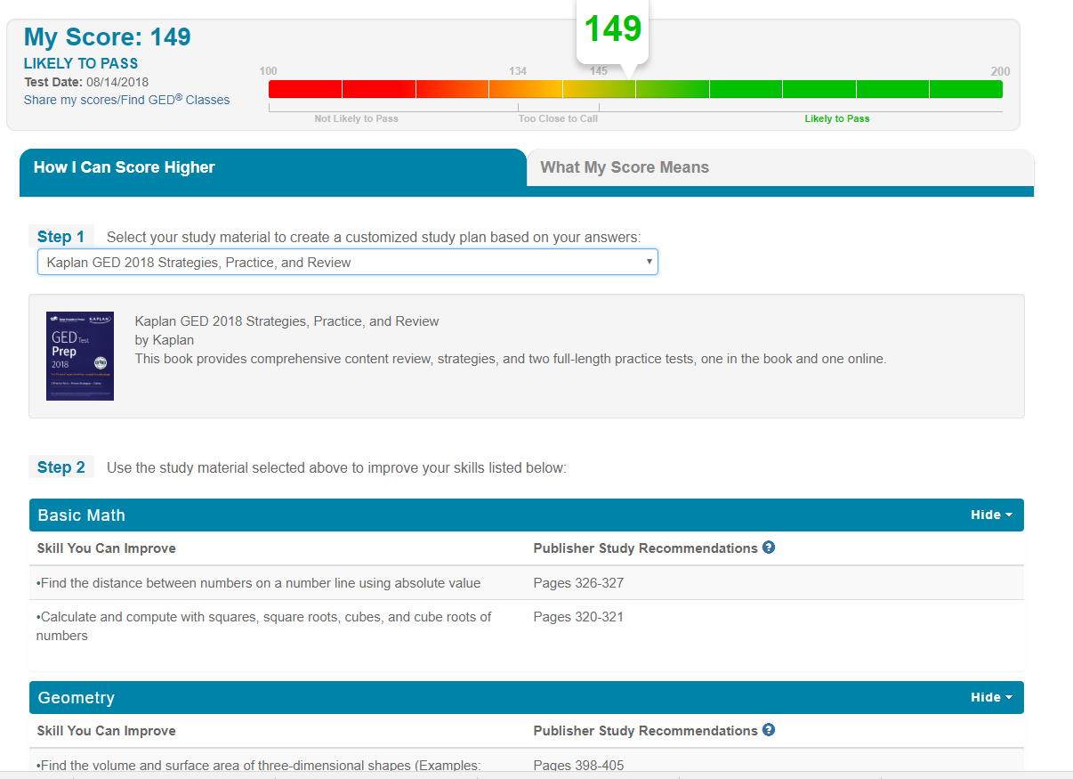

Slide 29
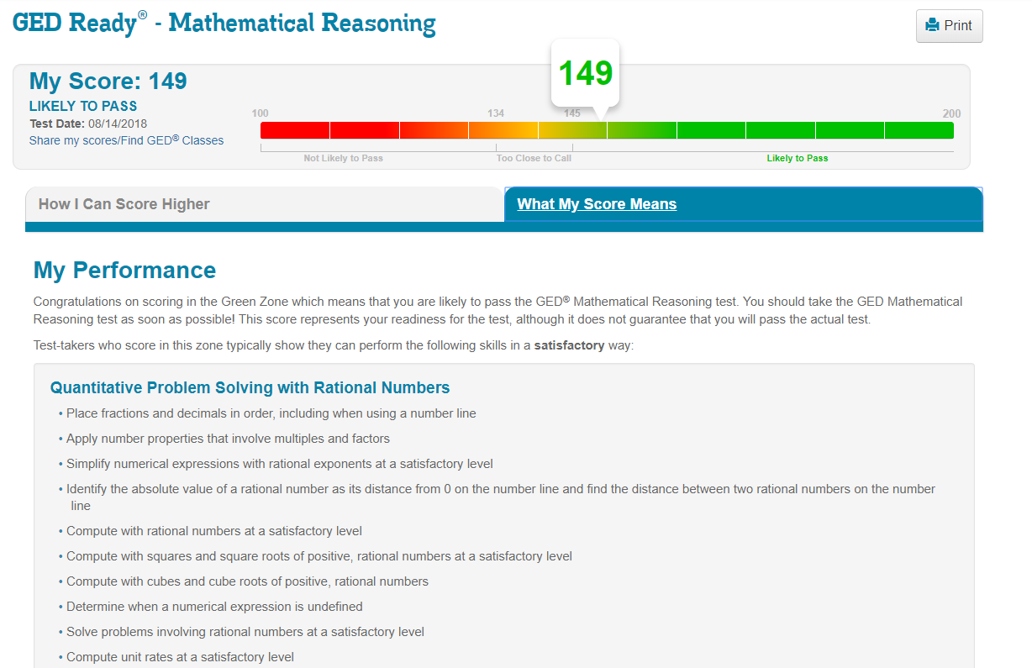

Slide 30
Choose fields for sorting
Enter parameters in as many of the criteria fields as desired (many are drop down menus)
Testing Activity: GED Passed/not passed, GED Ready range, if they have a test scheduled…
Date Range
Etc.

Slide 31
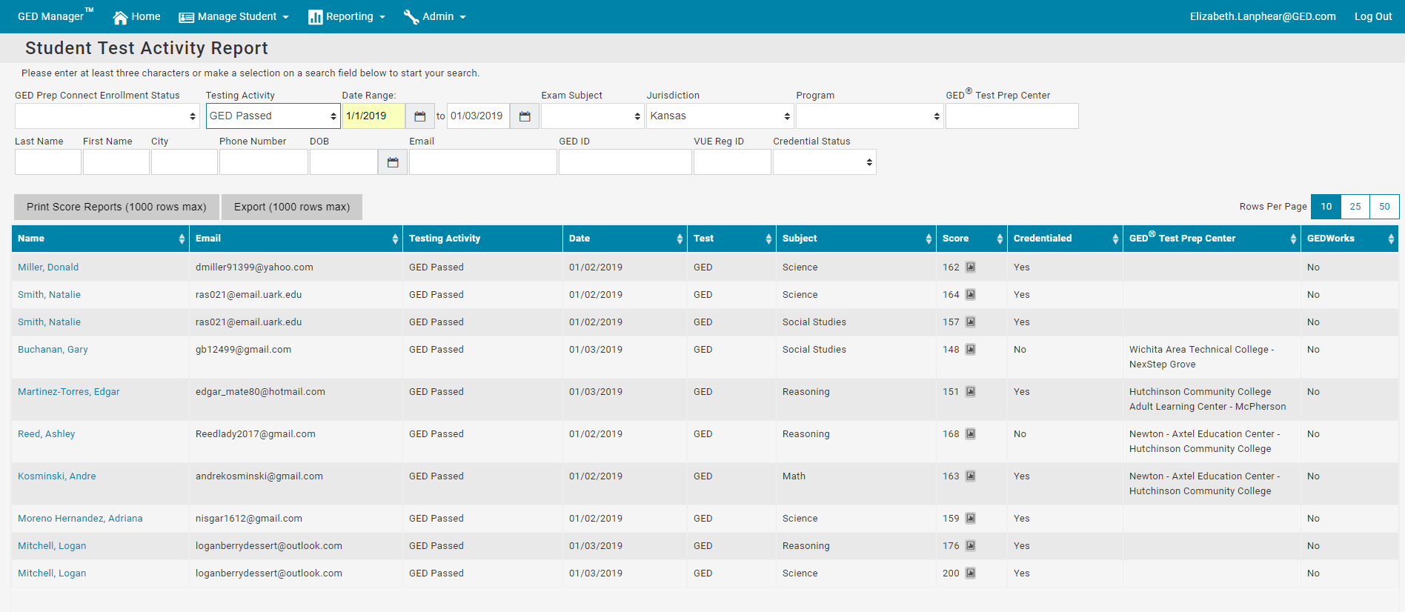
NOTE: It will only show your adult education center and only those students who chose to share their scores with you.
Click here to see their score report
Not choosing a selection in the “Testing Activity” drop down will show all statuses (GED Pass, not passed, GED Ready, etc.)

Slide 32
Print or Export Reports
Click on “Print Score Reports” to print bulk score reports based on search criteria
or
Click “Export” to create a csv file of the score reports

Slide 33
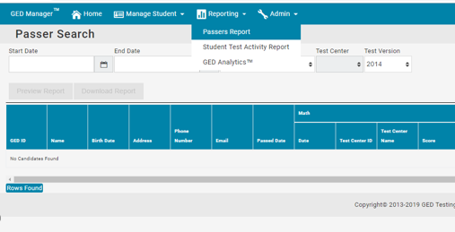
To get a passers report, click on “Reporting” and “Passers Report”
Enter the start and end date range

Slide 35
Requesting Access to GED Manager
Let your center director know you want access to GED Manager. They will contact Stephanie Patton at the State office to request access.
You will receive log-in information and an overview guide to get started.
Let me know if you have any questions or need further guidance on using it
Elizabeth.Lanphear@ged.com, 913-283-0121

Slide 36
GED Manager Accounts
User accounts will be inactivated after 180 days of not logging into GED Manager. If you attempt to log in after this period of time you will be notified that your account is inactive
Inactive users that still need GED Manager will have to go through a process of being re-approved for access.

Slide 37
GEDWorks^{tm}

Slide 38
What is GEDWorksTM
GEDWorks™ is a program designed for employers to sponsor the GED® test for their employees
All-inclusive program gives the student all the tools they need to pass the test
Available nationally
www.GEDWorks.com

Slide 39
Our Partners Include
Our Partners Include
Pizza Hut
KFC
Taco Bell
American Tire Distributors
American Hotel & Lodging Association
Jiffy Lube
Total Wine & More
Red Roof
Winn Dixie
Manpower
Chili’s
Maggiano’s Little Italy
Texas Dept. of Transportation
Sheetz
Penguin Random House
Scholastic
Royal Cup
Harvey’s
Bi-Lo
Pearson

Slide 40
Benefits for Employees
No out-of-pocket expense
Paid for by the employer. Student pays nothing out of pocket
GED Advisor™ to monitor and guide progress
Each student assigned an advisor to guide them along the way
Test pass guarantee
Students receive unlimited access to prep material, practice tests and GED tests until they pass
Exclusive Facebook community
Participants motivate and encourage each other
Digital or print curriculum
Unlimited access, both in English and Spanish,
focused on student learning styles.
National footprint
There are over 3,000 test centers where a student can test
Notes:
- GED Advisor for encouragement, motivation and help
- Some employers are offering rewards for passing the test

Slide 41
Results Prepping for the GED®

Slide 42
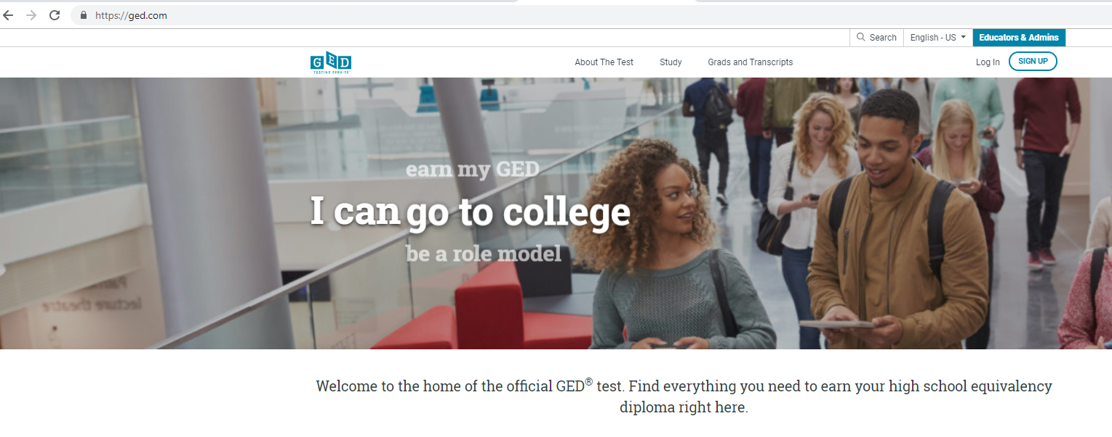
GED.com click on “Educators & Admins”

Slide 43
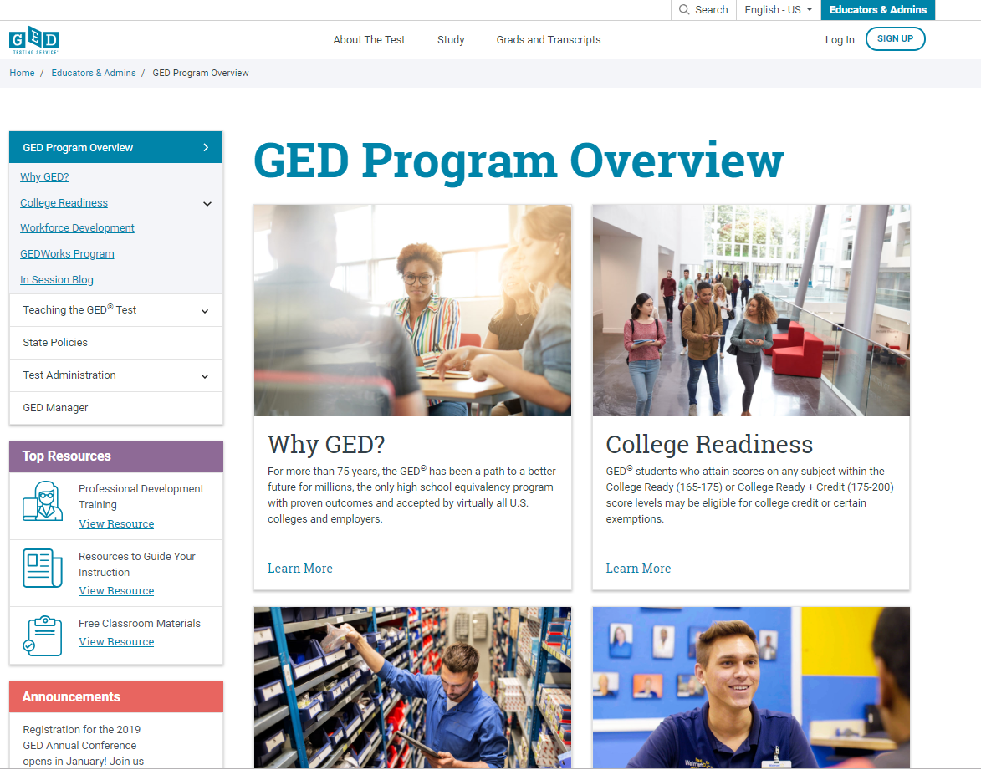

Slide 44
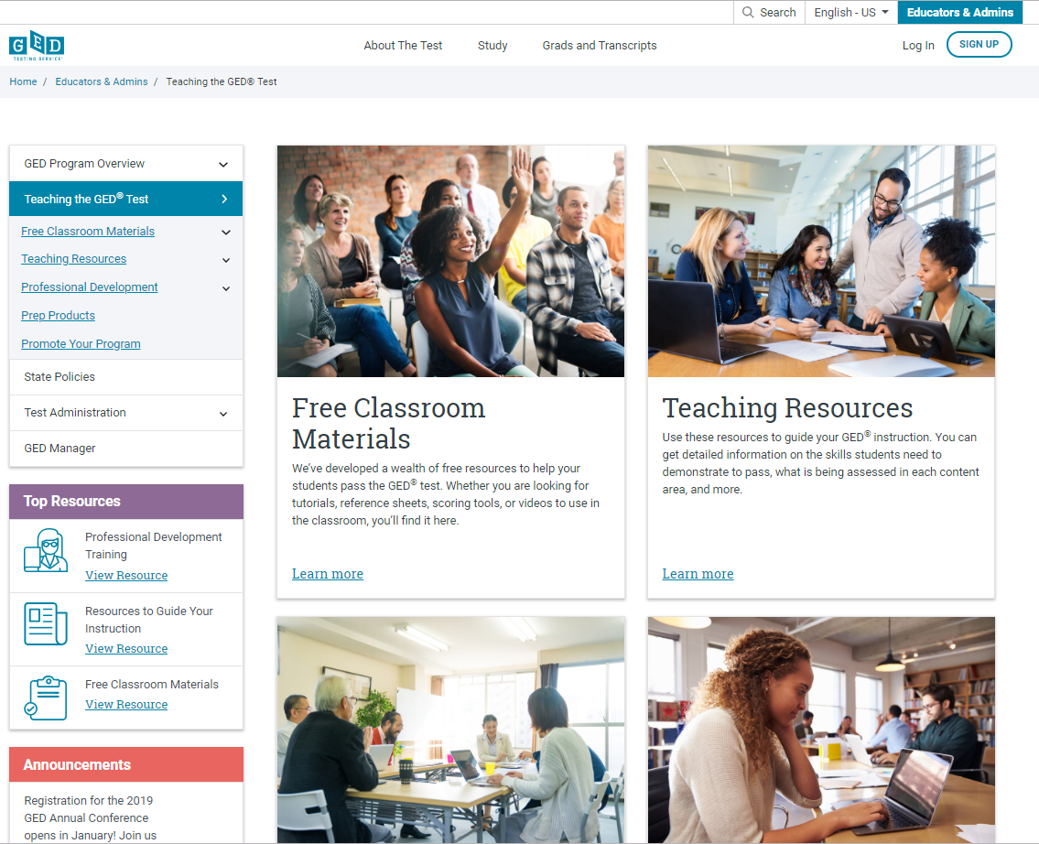
Educator resources galore!
Click here!

Slide 45
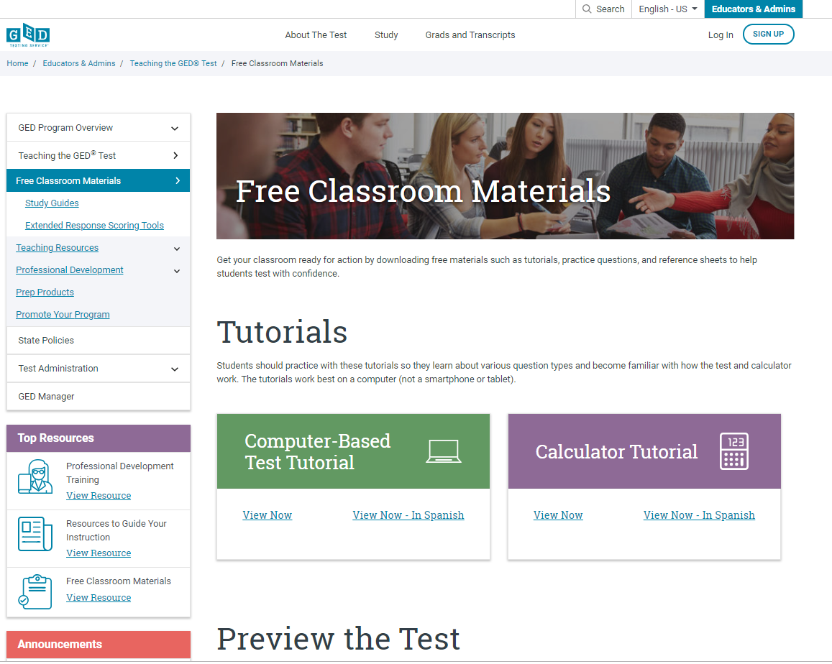
Free Classroom Materials

Slide 46
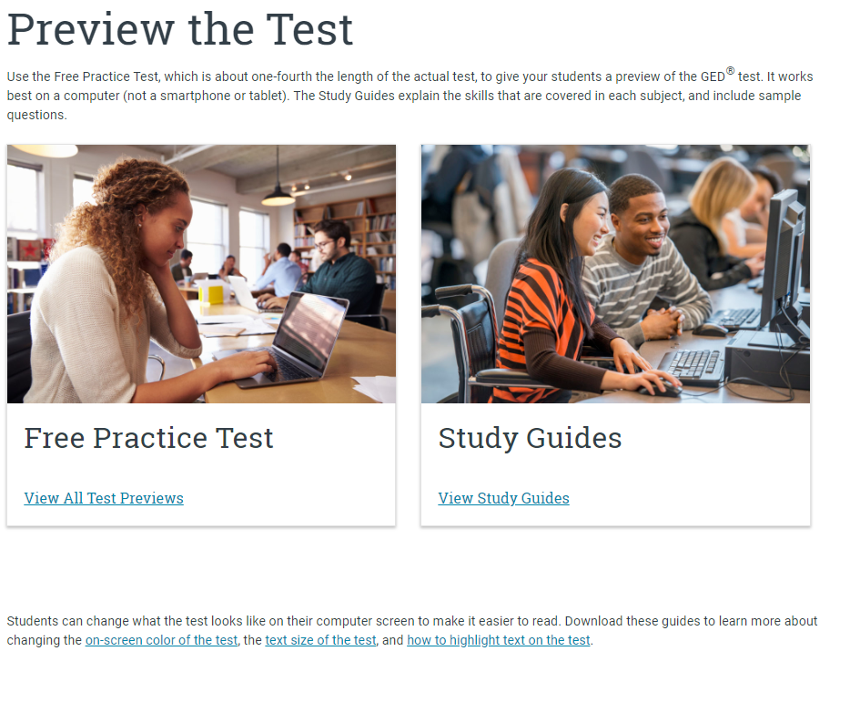
Practice Test and Study Guides

Slide 47
GED Student Study Guide
Available for all 4 subjects (no cost) via each student’s ged.com account
Includes sample questions
Another resource for adult educators to use in their preparation with students, under Educators & Admins tab on ged.com
Good tool for new teachers to get them familiar with the content they need to teach

Slide 48
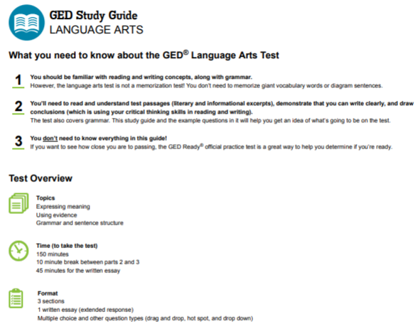
Each study guide covers topics, time for the test, format and example questions –

Slide 49
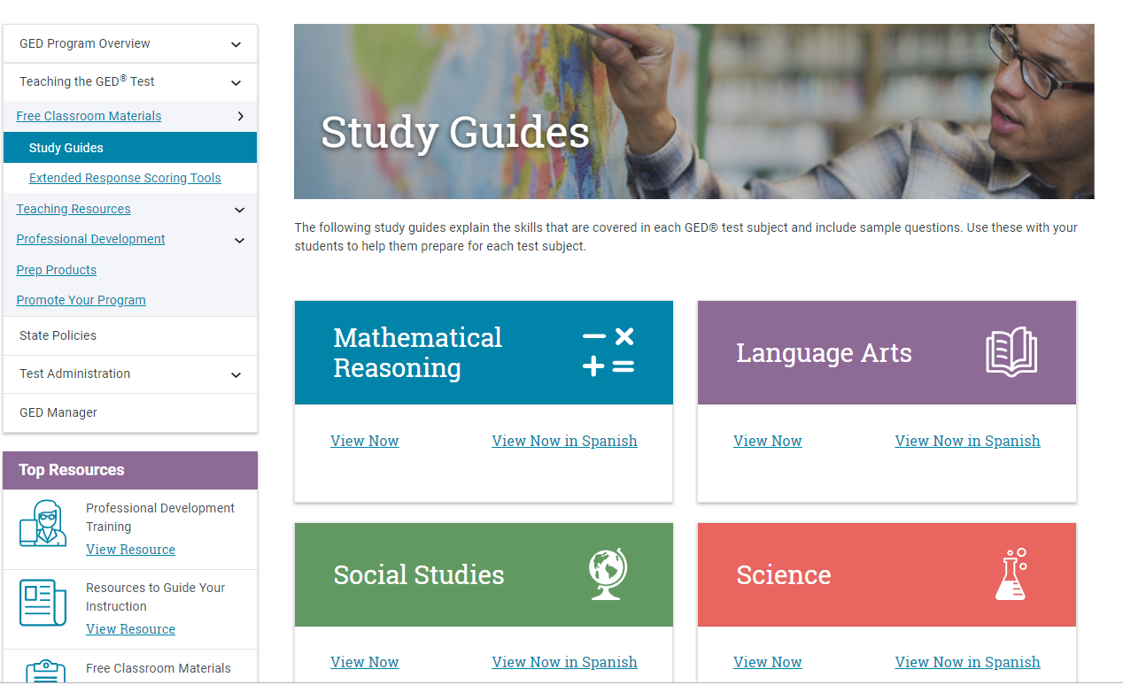
Study Guides

Slide 50
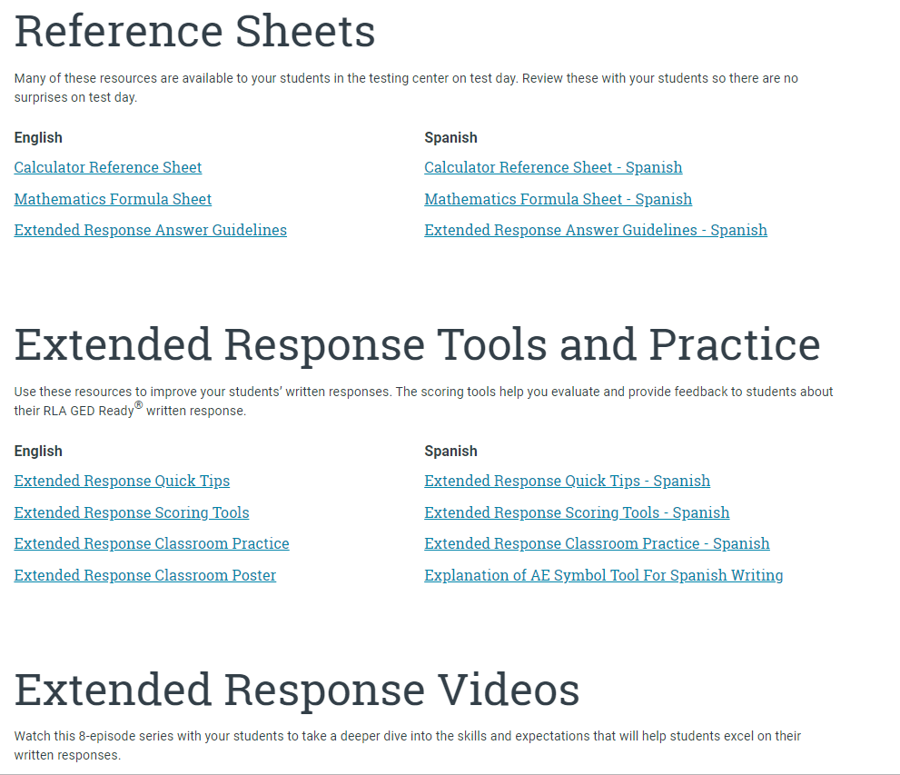
Reference Sheets & Extended Response tools

Slide 51
Reference Sheets & Extended Response tools

Slide 52
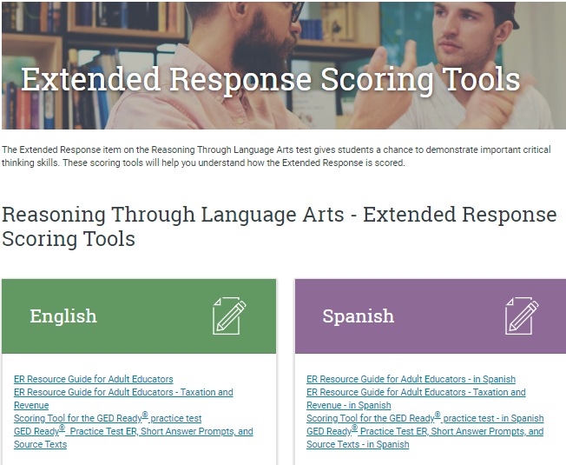
Brand New!

Slide 53
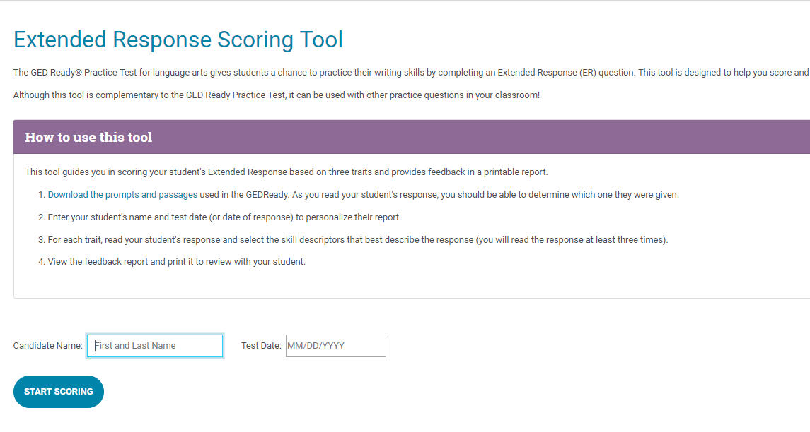
Brand New! Extended Response Scoring Tool for the GED Ready®

Slide 54
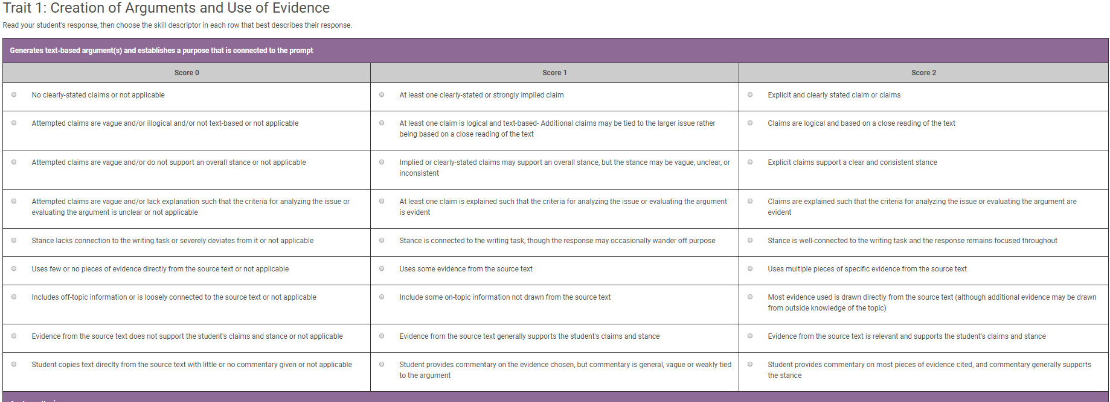
Sample of Trait 1
Click the “radio button” next to the most appropriate score, continue until all traits are scored
(Enlarged view)

Slide 55
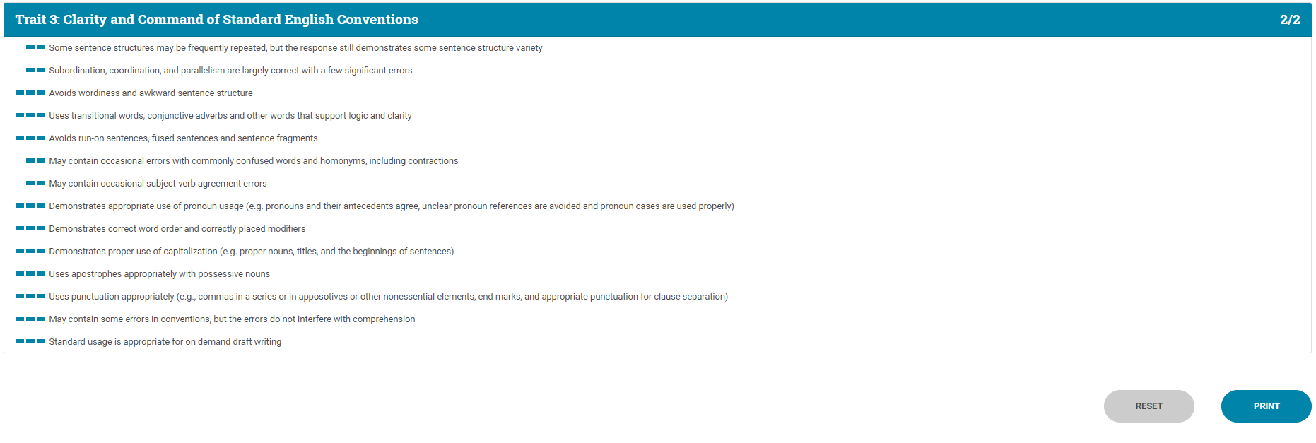
Once traits are scored, you will see the results. These can be printed.
(Enlarged view)

Slide 56
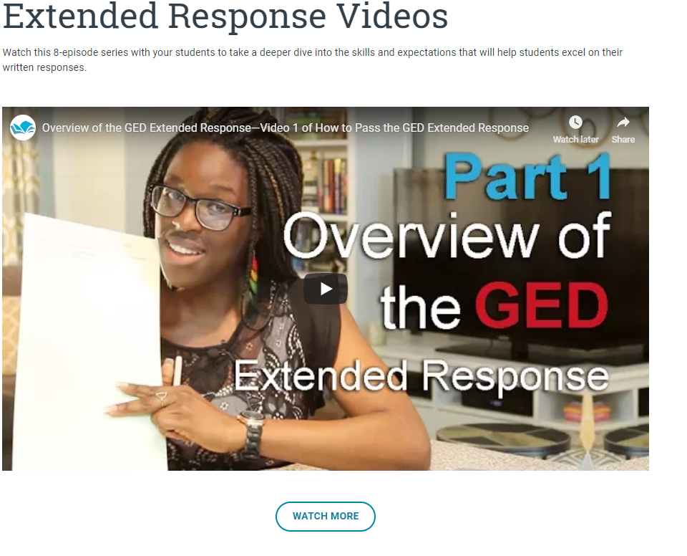

Slide 57
Where to find the videos
Available on GED.com in each student’s account under the “Study” tab
Available for educators here: https://ged.com/educators_admins/teaching/classroom_materials/
Available at: www.newreaderspress.com/writing-for-the-ged-test
Or contact New Readers Press for DVDs that can be sent to your facility:
tlipke@proliteracy.org
Videos are FREE

Slide 58
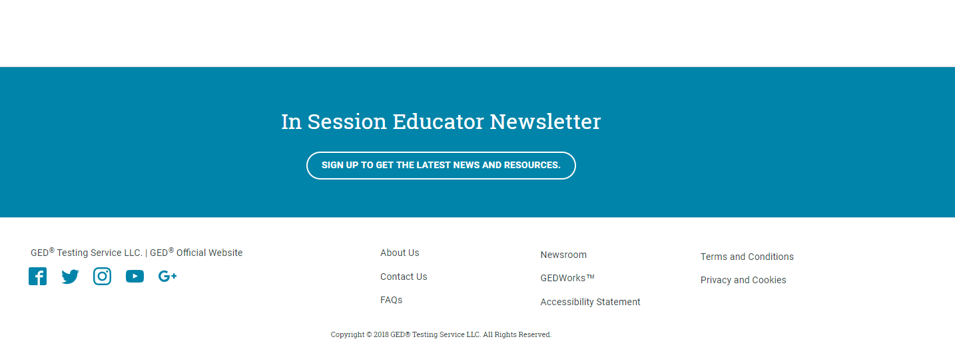
In Session Educator Newsletter Stay up-to-date by subscribing
At the bottom of each of the pages is an opportunity to sign up for the
In Session Educator Newsletter – please take the opportunity to sign up and stay informed on the latest news, resources, pricing specials, etc.

Slide 59
Scroll back to the top and click on “Teaching the GED® Test” again to see additional resources…

Slide 60
Let’s look at the Teaching Resources!
Click here!

Slide 61
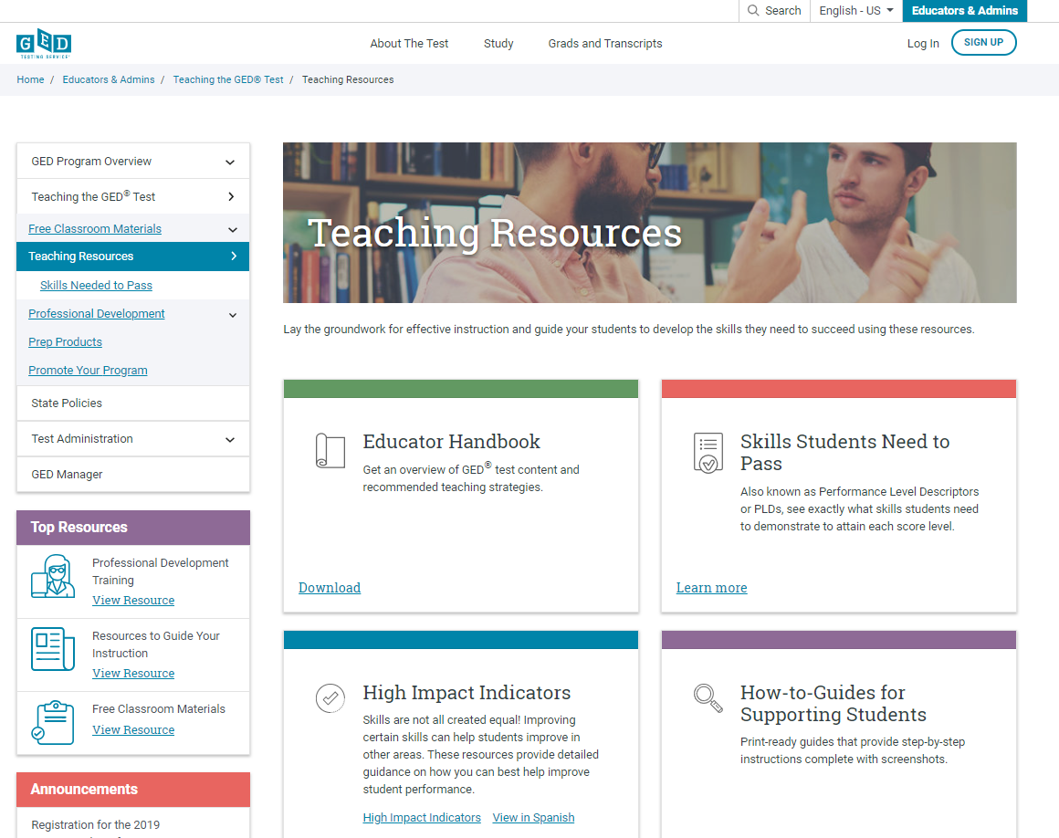
Teaching Resources

Slide 62
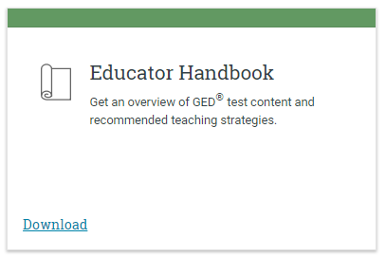
Educator Handbook
Get an overview of GED® test content and recommended teaching strategies.
In other words:
Start here!

Slide 63
New Educator Handbook!
Download at GED.com/educator_handbook

Slide 64
New Educator Checklist!
Our ”New Educator Checklist” is located right inside the new Educator Handbook
This is designed to help new teachers focus on the most important resources to get them up to speed on being a GED instructor

Slide 65
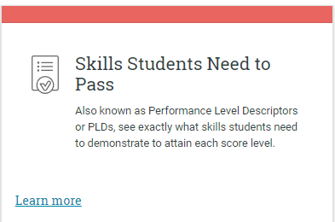
Skills Students Need to Pass
Also known as Performance Level Descriptors or PLDs, see exactly what skills students need to demonstrate to attain each score level
GED® Test Performance Level Descriptors
The four performance levels for the GED® test are Below Passing, Passing for High School Equivalency, GED® College Ready, and GED®College Ready + Credit.
Performance Level Descriptors Chart
Breaks down the descriptors for all four subjects by performance level in an easy-to-read chart.
Assessment Target Comparison Chart
Compares the official indicator code language with the language test-takers see in their score report.
Performance Level Descriptors
A full listing of all Performance Level Descriptors for all four subjects.

Slide 66
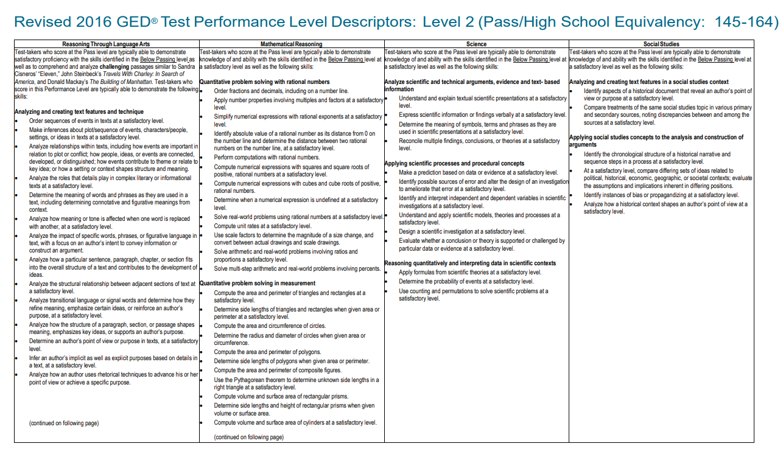
Performance Level Descriptors - chart

Slide 67
Assessment Target Comparison Chart

Slide 68
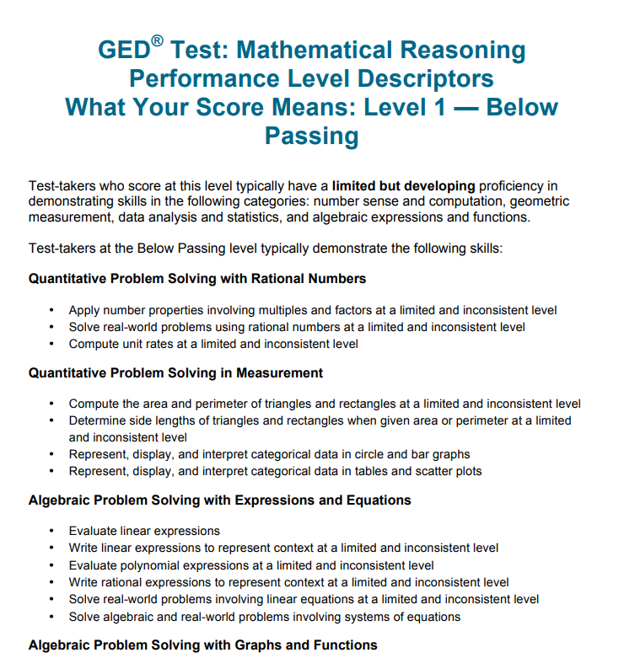
Performance Level Descriptors

Slide 69
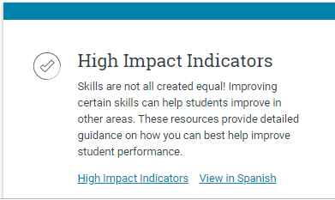
High Impact Indicators
Not all skills are created equal!
Improving certain skills can help students improve in other areas. These resources provide detailed guidance on how you can best help improve student performance.

Slide 70
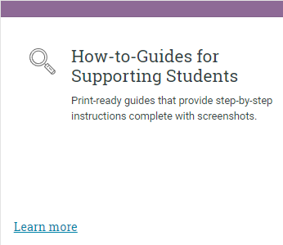
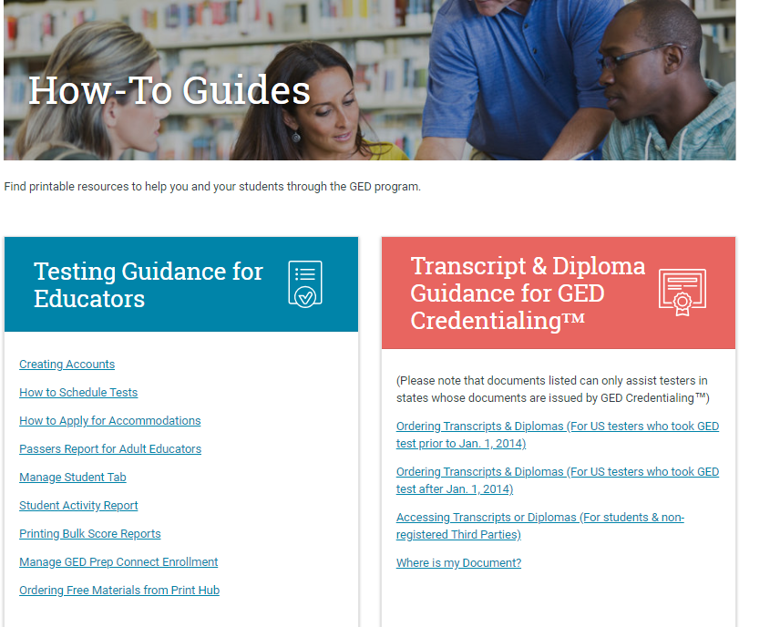
How-to-Guides for Supporting Students

Slide 71
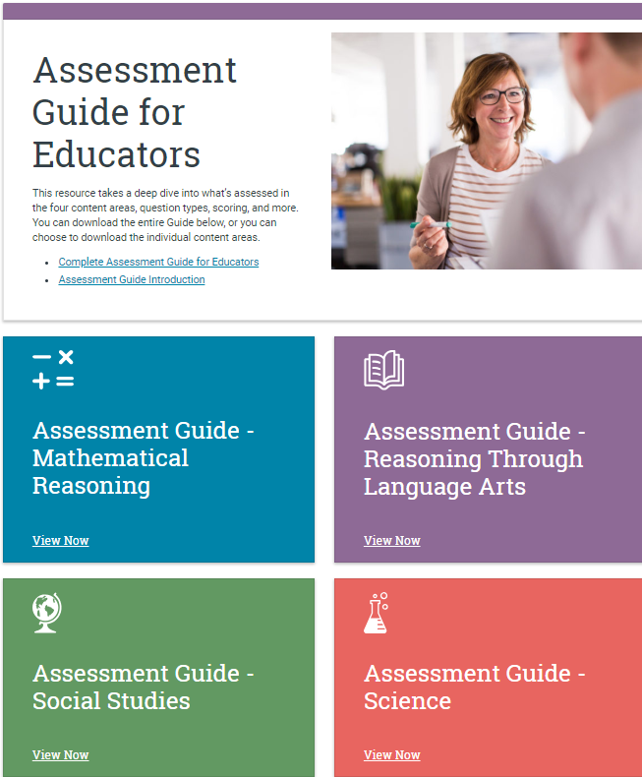
The Complete Assessment Guide is 230 pages
It’s also broken down into each subject (40-60+ pages each)

Slide 72
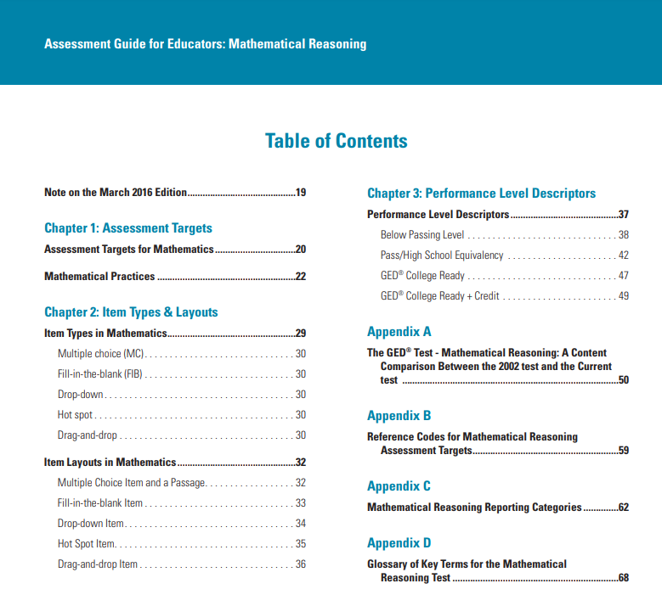
Assessment Guides for each subject

Slide 73
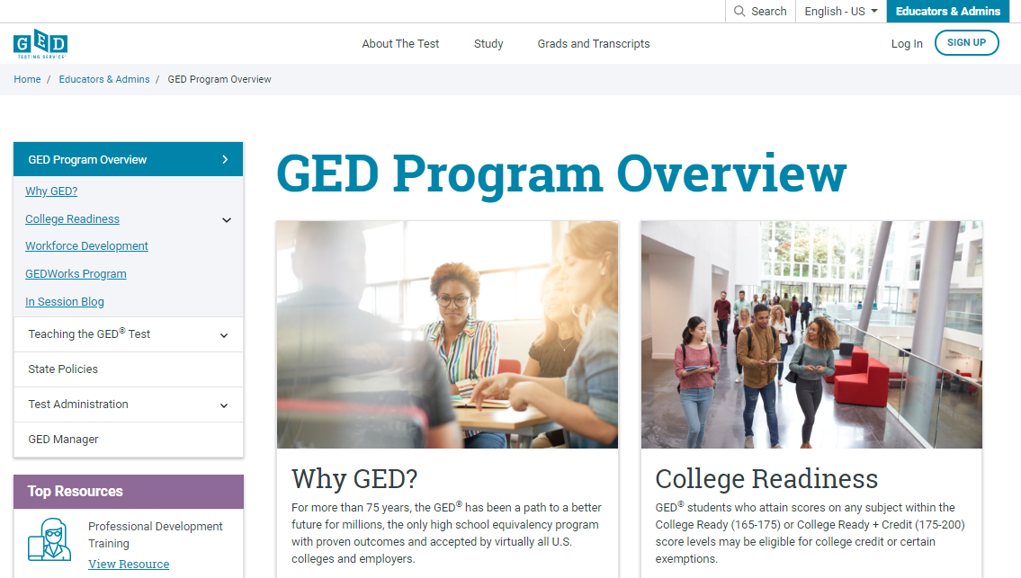
Professional Development

Slide 74
Test-taking tools

Slide 75
https://ged.com/about_test/accommodations/

Slide 76
Test Demonstrator
Use the Test Demonstrator to explore tools prior to the test
https://ged.com/practice-test/en/computer-demonstrator

Slide 77
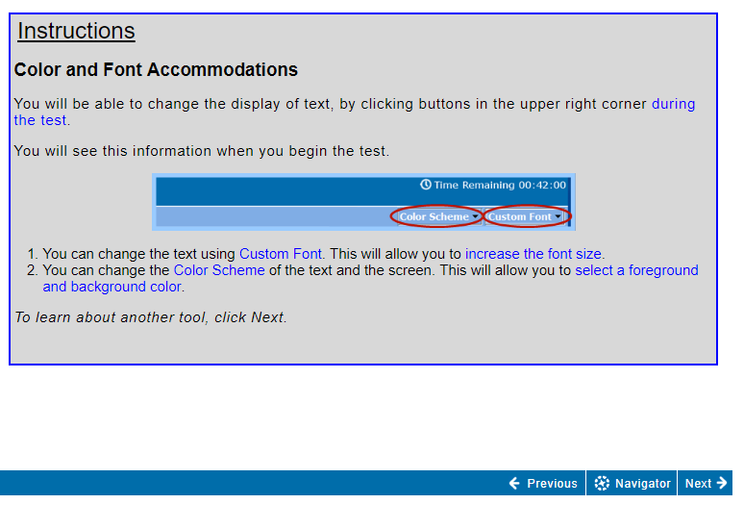
Changing the screen color and font

Slide 78
Using the highlight tool

Slide 79
Additional tools to use during the test

Slide 80
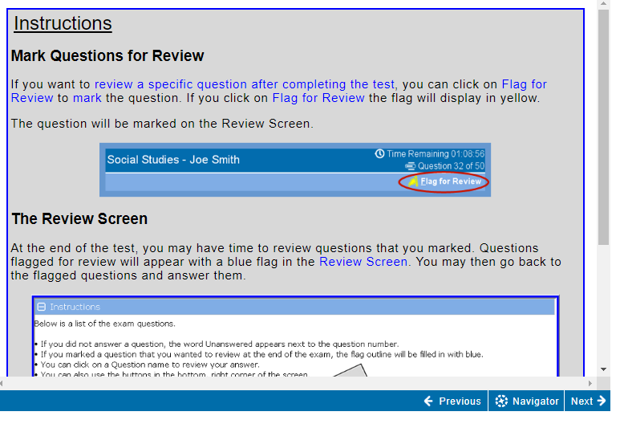
Using the Flag for Review

Slide 81
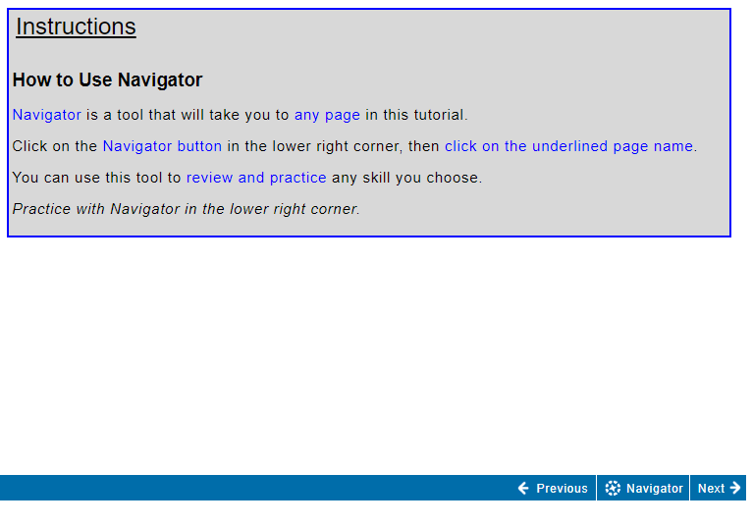
Using the Navigator

Slide 82
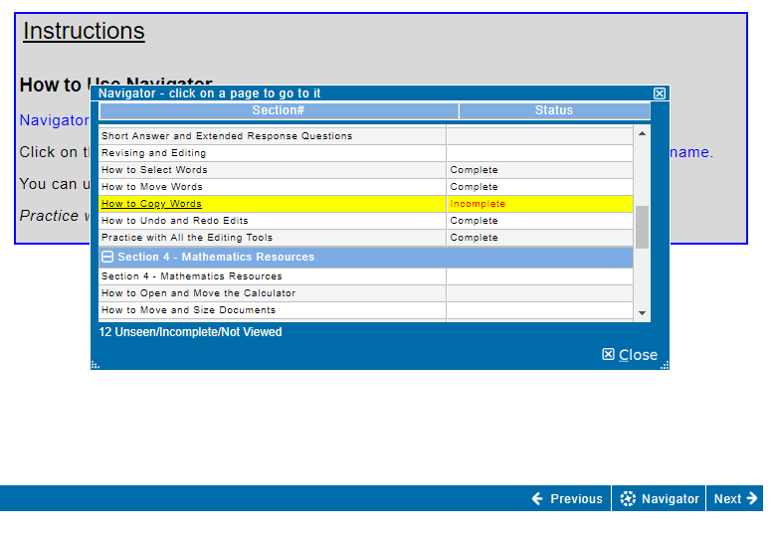
Using the Navigator

Slide 83
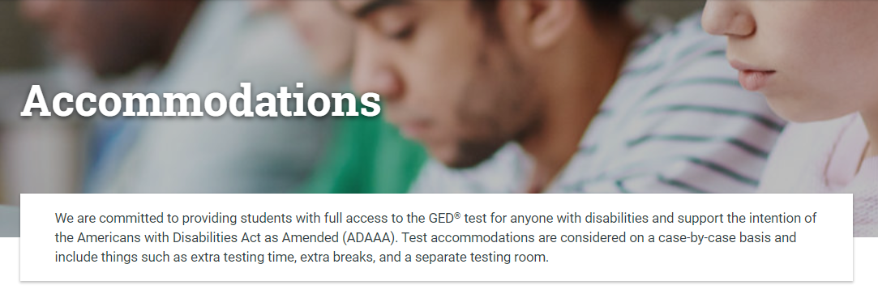
Accommodations

Slide 84
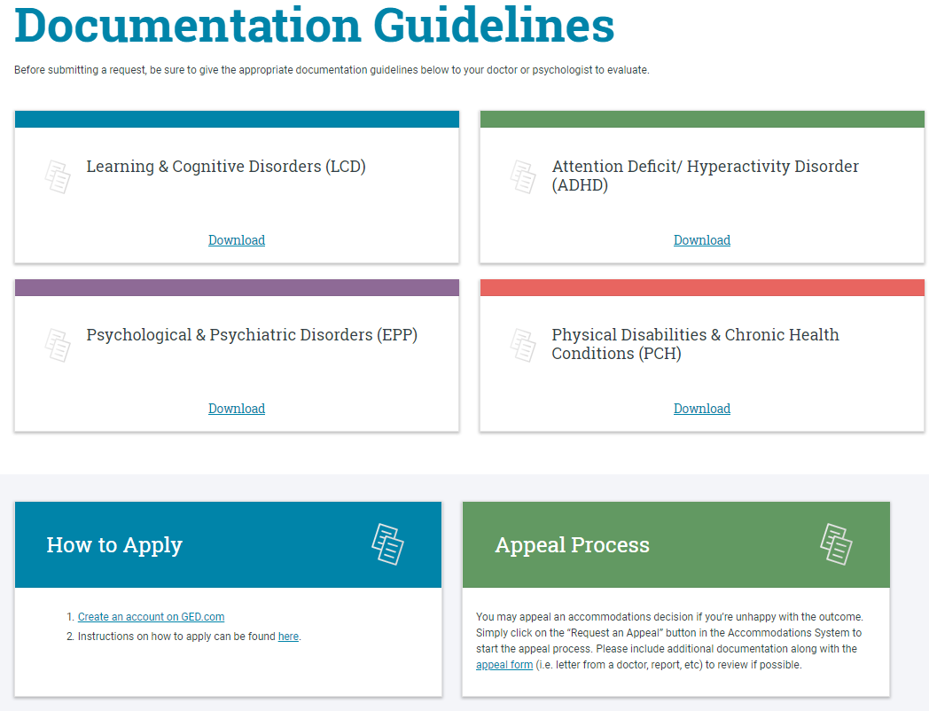
How to apply for Accommodations https://ged.com/about_test/accommodations/

Slide 85
Vendor Products

Slide 86
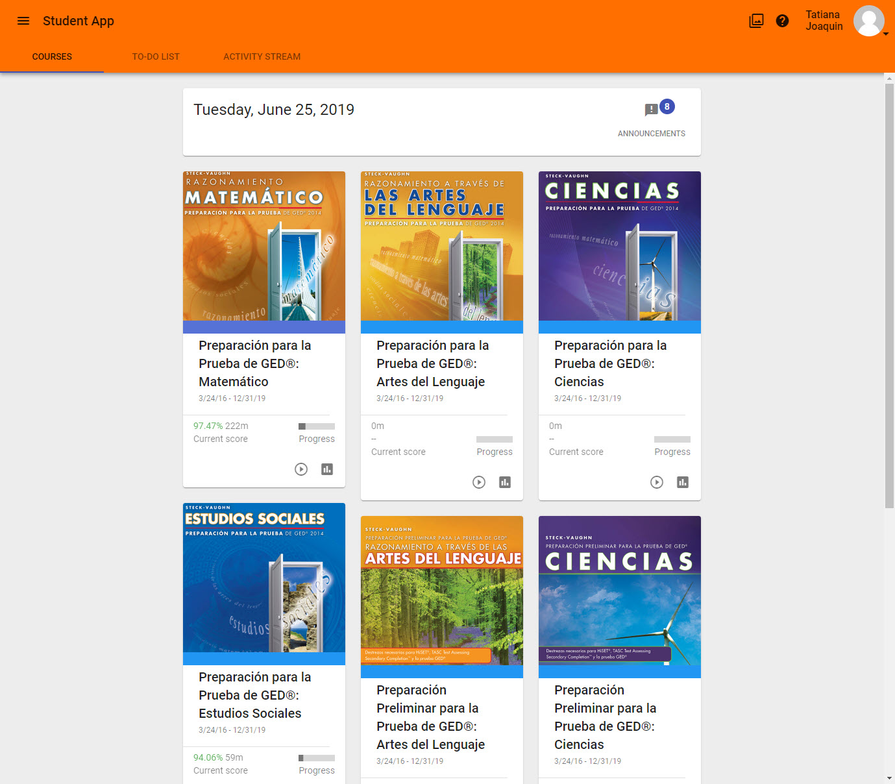
Paxen Focus in Spanish

Slide 87
What % of students take at least one GED® subject test in Spanish?
a. 0 – 2%
4.6%
b. 3 – 5%
c. 6 – 10%
d. More than 10%

Slide 88
What % of GED® test-takers are Hispanic or Latino?
a. 0 – 10%
25%
b. 11 – 24%
c. 25 – 35%
d. More than 35%

Slide 89
Teachers wanted more GED® prep materials for their Spanish-speaking students
GED Testing Service partnered with Paxen Publishing to promote Paxen Focus Spanish digital courseware, which is based on content from Steck-Vaughn books

Slide 90
Online courses with audio, video and interactive content developed specifically for adult learners
100% Aligned to the GED® Test

Slide 91
Real-time monitoring of students’ performance, skills mastery and time on task

Slide 92
Paxen Focus Spanish courseware eliminates the language barrier and allows our students to focus on the content.
- Principal, Post Correctional Facility
The lessons are engaging and students can easily follow the content from one topic or skill to the next. Built in tests and quizzes give instructors the ability to gauge students’ progress so that when necessary, they can fill learning gaps that are evident.
- Instructional Specialist, Palm Beach County

Slide 93
To learn more about Paxen Focus in Spanish:
Stop by Paxen’s booth during the conference
Email customerservice@paxenpublishing.com and be sure to include the state where your program is located

Slide 94
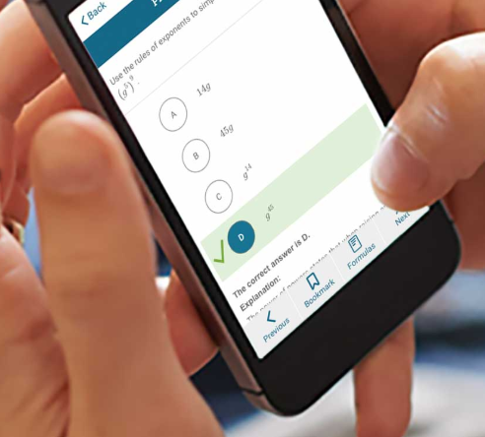
GED Flash®

Slide 96
Knowing that 75% of students surveyed wanted more practice to prepare for the GED® test, what could we provide to them to help them practice, learn and feel more confident for the test?

Slide 97
Practice and Feedback!
93% of students indicated they are interested in more practice test items and feedback
#1 on the list of most-wanted resources
Accessible anywhere from a mobile phone, tablet or computer
Available for adult education programs – GED Flash for Organizations
Available to students studying on their own (monthly access fee)
Notes:
Key Points
GED Flash for Individuals™
Details: Online, interactive tool that functions similar to traditional flashcards, giving users the option to test their knowledge of GED test subjects with instant feedback. It offers thousands of practice questions in each of the four GED test subjects, and it was created to be easily used on students’ mobile devices. Target test subjects: All (Math, Science, RLA, Social Studies) Benefits: Provides instant feedback on which questions students got right or wrong, giving the information they need to develop study plans and identify the skills they need to improve to pass the test. Questions are randomized and students have access to more than 6,000 practice items. Cost: Available in a 30-day subscription per subject, subscriptions can be renewed. Special promotion: Now through July 15, students can purchase access to GED Flash for $3 off per 30-day subscription of individual subjects using the promo code SUMMERFLASH. How to buy: Students can purchase subscriptions to GED Flash through their GED.com accounts
GED Flash for Organizations™
Details: Similar to the GED Flash for Individuals product. Allows programs and instructors access to the same questions and answers available to individual students, with the addition of tracking and interpretive tools. Target test subjects: All (Math, Science, RLA, Social Studies) Benefits: Features include reports that show students’ time on task; data related to individual, class and organizational progress; the ability to assign content areas based upon individual or class needs and administrative dashboards that provide quick and easy access to information and tools. Educators can assign multiple students to purchased “seats” as long as students are not using the product at the same time. Cost: Cost varies according to number of seats purchased Special promotion: Now through August 31st educators can purchase GED Flash “seats” for 14 months at the 12-month price and get GED Ready practice tests for $2 each per GED Flash “seat.” How to buy: Adult education and GED prep programs can purchase by contacting their state relationship manager or Aztec Software.

Slide 98
Practice and Feedback!
Adult education programs purchase via Aztec Software
Adult education programs who use this product will have access to administrative reports showing student performance data, time on task, strengths & weaknesses
More than 6,000 practice test questions across the 4 subject areas
Instant feedback with answer explanation
http://www.aztecsoftware.com/gedflash/
Notes:
Key Points
GED Flash for Individuals™
Details: Online, interactive tool that functions similar to traditional flashcards, giving users the option to test their knowledge of GED test subjects with instant feedback. It offers thousands of practice questions in each of the four GED test subjects, and it was created to be easily used on students’ mobile devices. Target test subjects: All (Math, Science, RLA, Social Studies) Benefits: Provides instant feedback on which questions students got right or wrong, giving the information they need to develop study plans and identify the skills they need to improve to pass the test. Questions are randomized and students have access to more than 6,000 practice items. Cost: Available in a 30-day subscription per subject, subscriptions can be renewed. Special promotion: Now through July 15, students can purchase access to GED Flash for $3 off per 30-day subscription of individual subjects using the promo code SUMMERFLASH. How to buy: Students can purchase subscriptions to GED Flash through their GED.com accounts
GED Flash for Organizations™
Details: Similar to the GED Flash for Individuals product. Allows programs and instructors access to the same questions and answers available to individual students, with the addition of tracking and interpretive tools. Target test subjects: All (Math, Science, RLA, Social Studies) Benefits: Features include reports that show students’ time on task; data related to individual, class and organizational progress; the ability to assign content areas based upon individual or class needs and administrative dashboards that provide quick and easy access to information and tools. Educators can assign multiple students to purchased “seats” as long as students are not using the product at the same time. Cost: Cost varies according to number of seats purchased Special promotion: Now through August 31st educators can purchase GED Flash “seats” for 14 months at the 12-month price and get GED Ready practice tests for $2 each per GED Flash “seat.” How to buy: Adult education and GED prep programs can purchase by contacting their state relationship manager or Aztec Software.

Slide 99
GED Flash for Organizations: An Interactive Tool to Help Students Pass
Developed in partnership between GED Testing Service and Aztec Software
This tool helps students prepare for each subject while building confidence step by step.

Slide 100
Data Shows: Improved Test Scores
Over half of regular GED Flash users moved up an entire score level on the GED Ready® practice test. Some moved up two score levels.

Slide 101
Data Shows: Higher Likelihood of Passing
GED Flash Group | # of Students | Mean GED® Math Test Score
Low Users (28 questions or less) | 1,483 | 144.676
High Users (99+ questions) | 1,491 | 148.531
Students who practiced frequently with GED Flash scored on average four points higher on their GED test vs. those who rarely used it.

Slide 102
Data Shows: More Practice Means More Correct Answers
GED Flash Group | Mean Percent Correct
99+ questions answered | 51.7%
340+ questions answered | 90.0%
The more students practiced, the more questions they got correct. Students who took over 340 GED Flash math questions achieved on average 90% correct.
More correct answers also means higher confidence: 79% of GED Flash users agreed that they felt more confident about taking the GED test after using GED Flash.

Slide 103
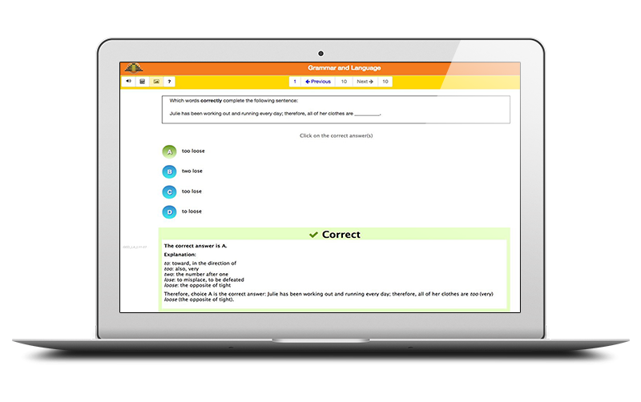
Mastering GED Test Concepts
GED Flash provides ongoing practice and detailed explanations to help students master the exact concepts on the GED test.
1,000’s of practice questions across the four GED test subjects
Instant feedback with step-by-step explanations provide additional teaching opportunity and reinforcement
Questions are aligned to and cover the exact skills from the test

Slide 104
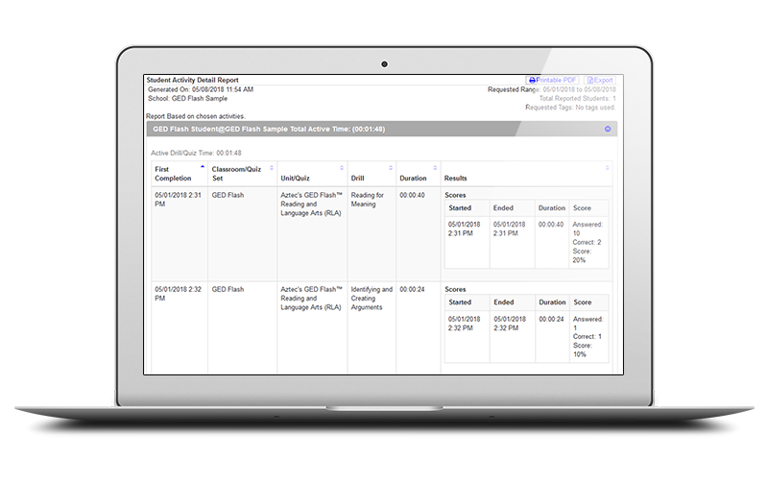
Detailed Reporting and Insights
A robust dashboard provides valuable insights about each student’s performance and areas for improvement.
Gain valuable insights on students’ strengths and areas for improvement
Track student usage progress and time-on-task

Slide 105
Ready to help your students and save money?
The licensing model is “concurrent” users
You only purchase the maximum # of licenses you will need at any one time
Ex. You have 100 students, but you anticipate that a max of 10 would be on at the same time. You can purchase just 10 licenses.
To receive 10% off the retail price of $125/license
See Rafa at the Aztec booth
email (sales@aztecsoftware.com) or
call Aztec (800-273-0033)
Provide discount code: FLASH10LL
Offer good for new customers and those adding additional licenses
Offer ends September 30, 2019

Slide 106
Results After the test

Slide 107
National Pass Rate—a comparison
Test Series | Year | Pass Rate
2002 | 2013 | 76%
2014 | 2018 | 80%
Students are passing the 2014 series test at a higher pass rate than the 2002 series test!

Slide 108
2018 National Data
Facts | Numbers
Test-takers | 300,726
Completers | 194,415
Passers | 155,571
Pass rates | 80%

Slide 109
2018 Utah Data
Facts | Numbers
Test-takers | 3,640
Completers | 2,662
Passers | 2,324
Pass rate | 87%

Slide 110
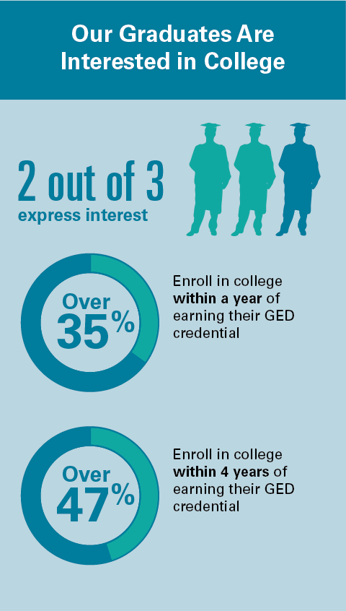

Slide 111
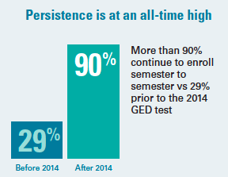
Persistence!
Congrats, all your hard work is paying off!
This number currently surpasses overall community college persistence rates

Slide 112
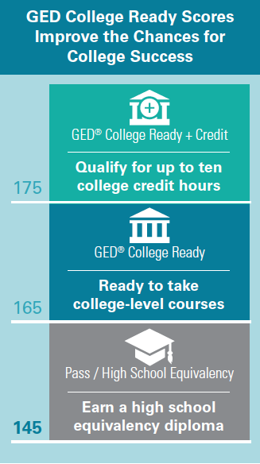
Scoring of the GED® Test
Notes:
Key Points
Briefly review each of the three levels. Discuss the importance of having a test that assesses students’ skills beyond the high school level. Explain that more students are looking at “what comes next” rather than “let me get that piece of paper.” More jobs require higher education and training and students who reach those College Ready and College Ready + Great have the skills necessary to purse higher education and training.
Remind instructors that it is important they know what their students want to do after earning a high school credential. With that information in hand, instructors can help students set appropriate goals in terms of skills they need and scores they want to achieve on the test.

Slide 113
Updated NSC Results
Mean scaled-score of GED graduates going on to college is well above the minimum passing score for high school equivalency:
Math: 158
RLA: 162
Science: 161
Social Studies: 161
Age of GED graduates going on to college has remained stable over time
81% to 86% of matched grads were between the ages of 16 and 24 when they received their credential

Slide 114
National Test-taker Data: 2014-2019
 | Math | RLA | Science | Social Studies
Passed | 85% | 89% | 93% | 90%
(145 or higher)
College Ready | 7% | 12% | 11% | 14%
(165 or higher)
College Ready+ Credit | 2% | 2% | 2% | 3%
(175 or higher)
Notes:
Key Points
Briefly review the information from the chart. Discuss the importance of the 20% of test-takers who earn College Ready or College Ready + Credit in at least one content level.
Spend some time reviewing the percent of students who are earning College Ready or College Ready + Credit. Discuss the fact that many programs focus primarily on the “passing” level rather than providing instruction at the higher levels. Explain that these numbers can increase if programs focus on providing instruction based on the PLDs and the HIIs.

Slide 115
Utah Data: 2014-2019 11,122 Completers / 10,020 passers
 | Math | RLA | Science | Social Studies
Passed | 90% | 94% | 96% | 95%
(145 or higher)
College Ready | 11% | 22% | 21% | 23%
(165 or higher)
College Ready+ Credit | 3% | 4% | 3% | 6%
(175 or higher)

Slide 116
GED® score crosswalk to SAT and ACT
SAT
GED® College Ready (165)
SAT Math – 620
SAT Reading – 633
GED® CR+Credit (175)
SAT Math – 657
SAT Reading – 671
ACT
GED® College Ready (165)
ACT Math – 28
ACT Reading – 29
GED® CR+Credit (175)
ACT Math – 30
ACT Reading – 31

Slide 117
About GED® College Ready (CR) and GED® College Ready + Credit (CR+)
GED®College Ready (CR) & GED® College Ready + Credit (CR+) score levels were created in 2016 in order to help move students more quickly into and through college certificate and degree programs.
Based on recommendations from the ACE Credit® program-the same program that backs CLEP and Advanced Placement (AP)
Students scoring at the GED®College Ready (CR) levels have demonstrated readiness to enter credit-bearing classes
Students scoring at GED® College Ready + Credit (CR+) have demonstrated college-level skills and knowledge.

Slide 118
American Council on Education (ACE) Recommendations for the GED® Test
GED® College Ready
Score of 165 - 174 on any content test
Waived from developmental education in that content requirements/courses
Waived from placement testing, and
Placed directly in credit-bearing courses
GED® College Ready+Credit
Score of 175 – 200 on any content test
Same as CR recommendations, plus
Up to 10 semester hours of college credit
Notes:
Key Points
Review the recommendations from the American Council on Education (ACE).

Slide 119
Many colleges have already adopted the ACE® Credit Recommendations
Approximately 225 colleges across the U.S. have implemented one, or both, of the recommendations (CR and/or CR+credit)
Colorado Community College System (both recommendations)
Connecticut Public College System
Georgia Technical College System
Illinois Community College System
Kansas Board of Regents (4-year colleges)
Kentucky Community College System
Ohio Community College System
Virginia Community College System
Additional Colleges in AL, AZ, KS, MA, MO, NJ, NM, OR, PA, RI, WA

Slide 120
We need your help!
Over 225 Colleges in the US have already accepted the College Ready and/or the College Ready + Credit recommendations
Will yours be next?
Please help increase awareness on your campus that the American Council on Education’s College Credit Recommendation Service (CREDIT®) has approved the College Ready + Credit scores for awarding credit (the same approval as CLEP and AP)
And the College Ready scores can allow test-takers to bypass another entrance exam (like Accuplacer, etc.)
I’m available – please let me know how I can help!

Slide 122
Thank you!
Liz Lanphear
State Relationship Manager (SRM)
GED Testing Service
Elizabeth.Lanphear@GED.com
913-283-0121

